Slide 1
Business Performance Analysis + Recovery Strategy
Quick Bazaar

Slide 2
Agenda
01
Project Overview
Slide 3
02
Objectives
Slide 4
03
Key Findings
Slide 5
04
Insights & Problem Areas
Slide 6-9
05
Recommendations & Solutions
Slide 11-12
06
Performance Improvement Target
Slide 13
Confidential

Slide 3
Quick Commerce has been facing declining revenue and customer dissatisfaction.
This project aims to identify operational bottlenecks, understand customer pain points, and provide actionable solutions using data-driven insights
Project Overview
Confidential

Slide 4
Objectives
Objective 1
Objective 2
Objective 3
Analyze customer dissatisfaction drivers.
Examine delivery performance and its effect on ratings.
Evaluate stock management and order value trends.
Objective 1
Objective 4
Recommend actionable strategies to improve sales and Operations.
Confidential

Slide 5
Key Findings : Overview
Average Order Value Decreased by 5% in last 12 Months
Average Delivery Time: 70.43 mins
Most Late Deliveries:Karnataka
Highest Stockouts: Groceries, Books, Toys
Confidential

Slide 6
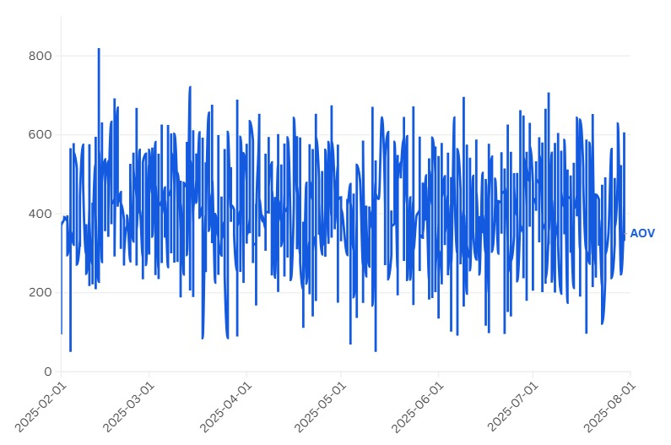
Key Findings : Average Order Value
Customers are spending less per order, likely due to declining satisfaction and reduced trust.
5 % Drop

Slide 7
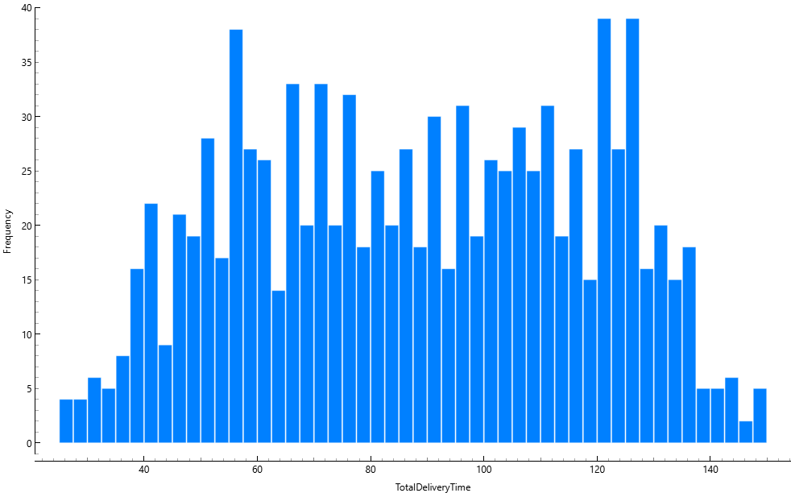
Key Findings : Delivery Performance
High variability in delivery times → inconsistent operations.
Average Delivery Time: 70.43 mins Standard Deviation: 28.71 mins

Slide 8
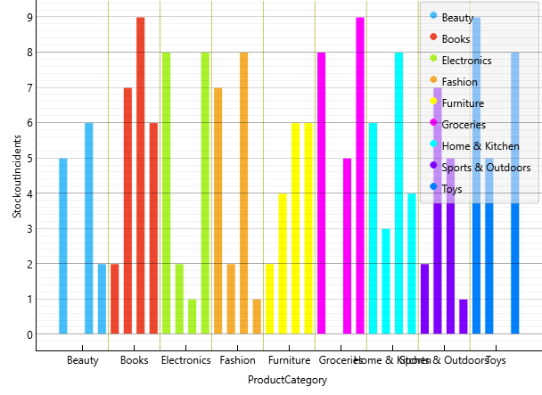
Key Findings : Stockouts
Groceries, books, and toys face highest stockout scenarios = demand-supply gap.

Slide 9
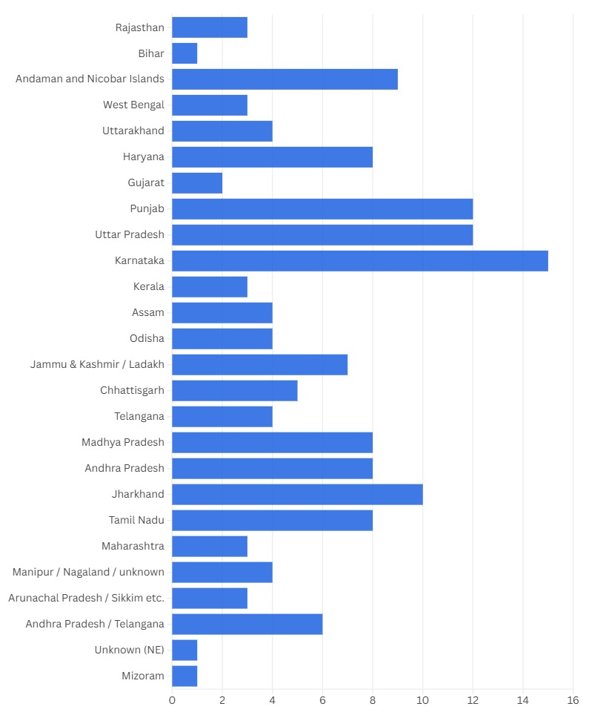
Key Findings: Regional Insights
Karnataka and Uttar Pradesh lead in late deliveries, requiring targeted operational improvements.

Slide 10
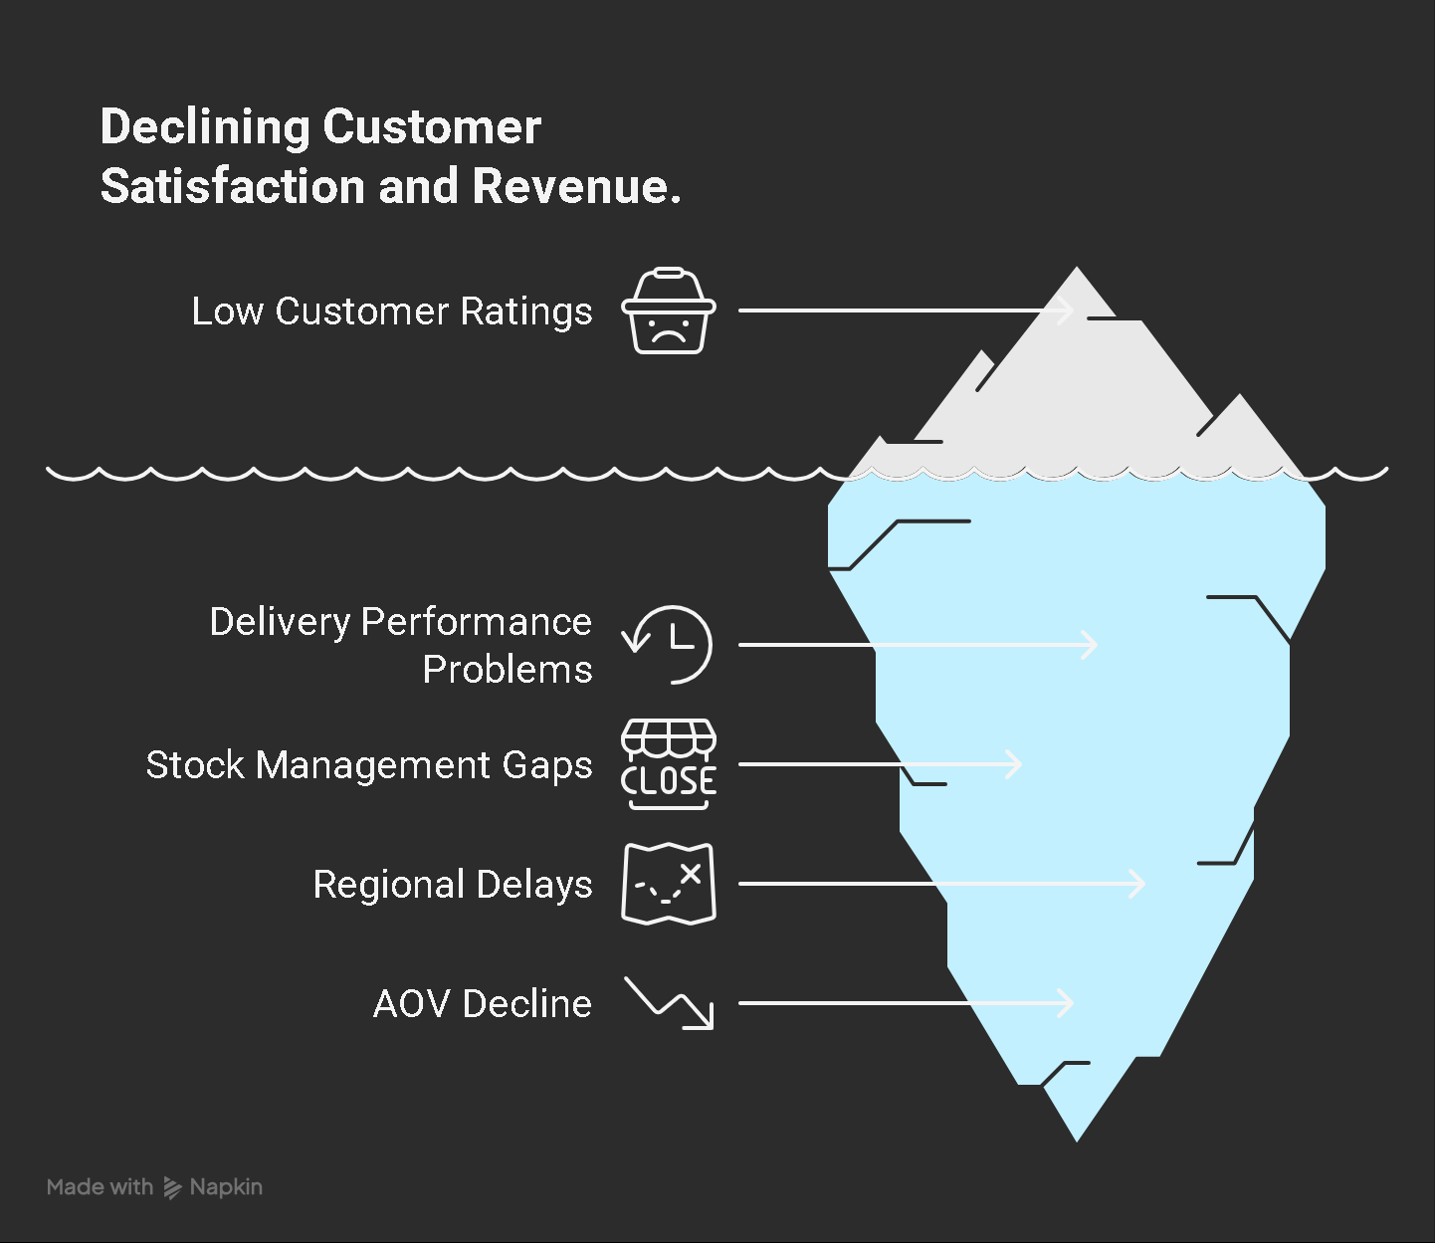
Confidential

Slide 11
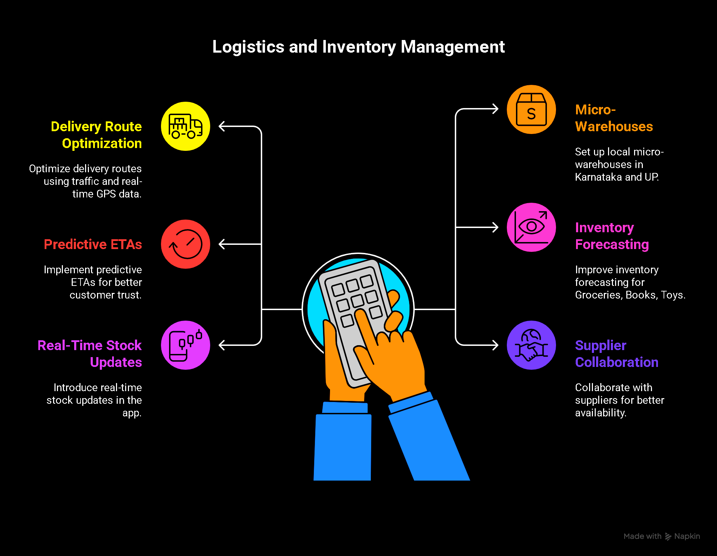
Solutions and Recovery Strategy
Confidential

Slide 12
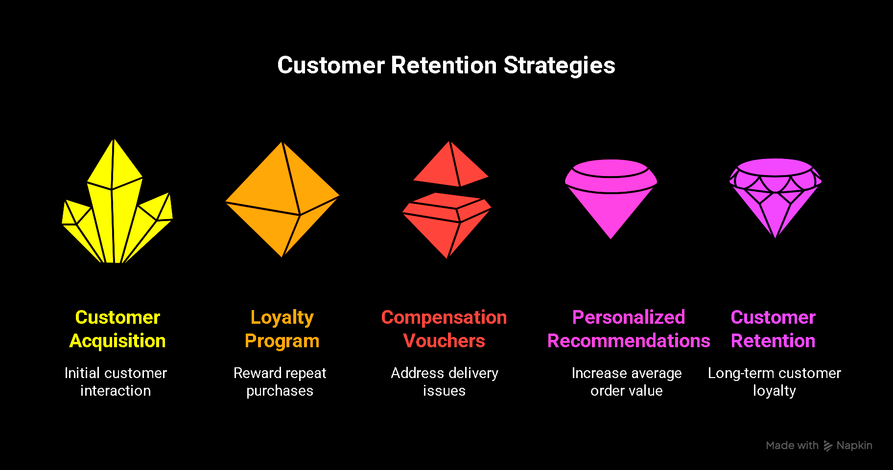

Slide 13
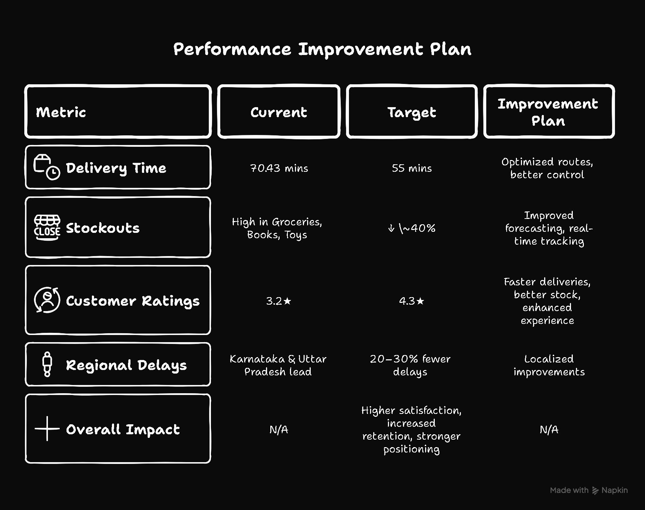

Slide 14
Thank You!

